Slide 1
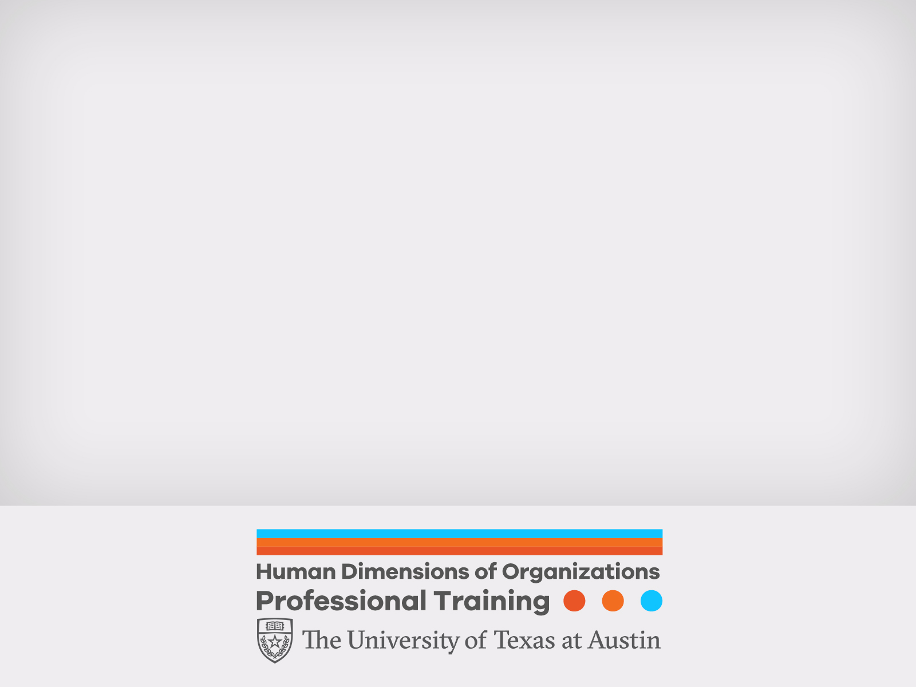
The Heart of Leadership: Moving Forward Through Change
Prof Paul Woodruff and AJ Josefowitz PhD
Human Dimensions of Organizations
Oct 25, 2018

Slide 2


Management vs. Leadership
Course Structure & Curriculum
Four Semesters, 15 Months
• Fall 2018
4 Classes, including Intensive Week (early August)
• Spring 2019
4 Classes, including Intensive Week (early January)
• Summer 2019
3 Classes, including Intensive Week (late May/early June)
• Fall 2019
No Formal Classes, No Intensive Week
Capstone Completion Period
Graduation Weekend (Wednesday to Saturday, early December)
Management
Planning & Budgeting
Organizing & Staffing
Controlling & Problem Solving
Leadership
Establishing Direction
Aligning People
Motivating & Inspiring
Management drives Predictability
Leadership drives Change

Slide 3
A Framework for Leadership
Course Structure & Curriculum
Four Semesters, 15 Months
• Fall 2018
4 Classes, including Intensive Week (early August)
• Spring 2019
4 Classes, including Intensive Week (early January)
• Summer 2019
3 Classes, including Intensive Week (late May/early June)
• Fall 2019
No Formal Classes, No Intensive Week
Capstone Completion Period
Graduation Weekend (Wednesday to Saturday, early December)
“The larger topic of which leadership is a subtopic is the accomplishment of group purpose.”
Who is your group?
What is your group’s purpose?

Slide 4
The Core of Influence
Course Structure & Curriculum
Four Semesters, 15 Months
• Fall 2018
4 Classes, including Intensive Week (early August)
• Spring 2019
4 Classes, including Intensive Week (early January)
• Summer 2019
3 Classes, including Intensive Week (late May/early June)
• Fall 2019
No Formal Classes, No Intensive Week
Capstone Completion Period
Graduation Weekend (Wednesday to Saturday, early December)
Leaders induce followers to act for goals that represent:
Values
Wants
Aspirations
Motivations
Needs
Expectations
…of both leaders and followers

Slide 5
The Genius of Leadership
“And the genius of leadership lies in the manner in which leaders see and act on their own and their followers' values and motivations.”
-James MacGregor Burns

Slide 6
Utility of Leadership
The ability to act in the face of paradox or uncertainty is the utility of leadership
Leaders help us find confidence in the face of ambiguity or doubt. In other words, leaders help us to act

Slide 7
What Moves You to Act?
Meaning The intersection of values, responsibility, and creativity
Hope
Goal-focused confidence, self efficacy, and resilience
Trust The demonstration of competence, character, and concern

Slide 8
The Heart of the Matter
Leaders help constituents find…
In service of their need for…
To help create…
Purpose
Meaning
Goals &
Objectives
Optimism
Hope
Energy & Creativity
Integrity
Trust
Reliability & Accountability
Supporting Dimension:
Encouragement
Growth
Self-Reliance & Leadership Development

Slide 9
The Heart of the Matter
Leaders help constituents find…
In service of their need for…
To help create…
Purpose
Meaning
Goals and Objectives

Slide 10
Meaningful Work Defined
Meaningful work is perceived as
Significant and important
Inherently fulfilling and rewarding
A good fit between ability, interest, needs, and values

Slide 11
Meaning At Work
Research shows that finding meaning in one’s work increases:
Motivation
Engagement
Empowerment
Career development
Job satisfaction
Individual performance
Personal fulfillment

Slide 12
Values, Purpose and Culture
Purpose is derived from values
A higher purpose is focused on a greater good that intersects with business interests and helps guide decisions
Culture reveals and reflects collective values
Effective leaders help constituents align personal and organizational values and purpose

Slide 13
The Utility of Purpose
“People with purpose have more resilience to face the stresses of everyday life. People without purpose get stuck in the small details of everyday life and forget the larger goals.”
-Aaron Hurst

Slide 14
Leading Meaning
“The leader’s most important job is to connect their people to their purpose”
-Joe Robies
Former CEO of USAA
Leaders effective at instilling meaning at work are transparent, honest, and influenced most strongly by their values
Leaders driven by internal processes (values and beliefs) more than external processes (social expectations and rewards), enhance workforce commitment, satisfaction, meaningfulness, and engagement

Slide 15
Take Aways
Be clear and communicative about your sense of purpose - Come to understand what’s really important to you - Create/seek opportunities to test yourself - Develop your “teachable point of view” - Let others know where you stand
Do not assume that others share your sense of purpose
Foster an environment that helps others “find” their own sense of purpose - Allow for exploration - Encourage questions - Use reflective questions; e.g. Why do you think that is? - Resist offering your solutions and answers “Ask” more than “Tell”
Identify and promote everybody’s shared purpose and values - Encourage conversation and activity about shared interests

Slide 16
So…
How can I promote more meaning and
purpose for myself and others at work?

Slide 17
The Heart of the Matter
Leaders help constituents find…
In service of their need for…
To help create…
Optimism
Hope
Energy & Creativity

Slide 18
Hope Creates Energy
Hope is a feeling that:
sparks creativity
accelerates activity
moves ideas to action

Slide 19
Psychological Capital (PsyCap)
Positive Psychology research identifies four constructs that in combination have a strong relationship with satisfaction and performance
Hope
Self-Efficacy
Resilience
Optimism

Slide 20
Hope
Hope is a positive feeling (a motivational state) about
a goal
a conviction and confidence about achieving it
a pathway for getting it done

Slide 21
Self Efficacy
“Whatever other factors may serve as guides and motivators, they are rooted in the core belief that one can make a difference by one's actions.
This core belief is the foundation of human motivation, performance accomplishments, and emotional well-being.
Unless people believe they can produce desired effects by their actions, they have little incentive to undertake activities or to persevere in the face of difficulties.”

Slide 22
Resiliency
Resilience – A positive way of coping with adversity or distress. In a work context it is the ability to recuperate from:
Stress
Conflict
Failure
Change
Increase in responsibility

Slide 23
Optimism
Making “internal" attributions (I did it) for positive events and “external" attributions (they did it) for negative events

Slide 24
The Utility of Optimism
Optimism is linked to good mood, perseverance, achievement, and physical health

Slide 25
Take Aways
Be solution-centered - Ground optimism in realism - Don’t seek to lay blame - Concentrate on making things better - Deal with the real issues at hand
Be Entrepreneurial - Look for opportunities - Be inquisitive, curious and consider a broad range of possibilities - Don’t be satisfied too easily
Be communicative and steadfast - Let others know what you are “excited” about and why - Manage rhetoric and action to accurately portray your optimism - Tell stories and strengthen lines of communication
Be intuitive - Believe in yourself, your constituents, and the organization - Beware of self-fulfilling prophecies - Look beyond the data

Slide 26
So…
How can I promote more hope and optimism for myself and others at work?

Slide 27
The Heart of the Matter
Leaders help constituents find…
In service of their need for…
To help create…
Integrity
Trust
Reliability & Accountability

Slide 28
Trust Defined
Trust is a belief that those on whom we depend will meet our expectations of them
Confidence is built on reason and fact
Trust is based in part on faith
Trust assumes that “they” will behave in a manner consistent with “our” interests

Slide 29
The Basics of Trust
Trust is founded on a few basic imperatives
(cores of credibility)
Competence: performance in fulfilling obligations and commitments (capabilities and results)
Character: honesty in words and consistency in action (integrity)
Concern: degree to which others support our well-being as measured by their degree of responsiveness in the face of potentially conflicting pressures (intent)

Slide 30
Self Assessment
Identify your strengths and opportunities for improvement from Covey’s 13 Trust behaviors
Talk straight (Character)
Demonstrate respect (Concern)
Create transparency (Character)
Right wrongs (Competence)
Show loyalty (Concern)
Deliver results (Competence)
Get better (All)
Confront reality (Competence)
Clarify expectations (Competence)
Practice accountability (Character)
Listen first (Concern)
Keep commitments (Competence)
Extend trust (Character)

Slide 31
Trust in the Context of Teamwork
Trust that each member is accepted by others on the team
Trust that work and credit for results is shared appropriately
Trust that the commitment to do well is shared and demonstrated
Trust that individual opinions and contributions are heard and valued
Trust that team members help one another
How strong is trust on your team?

Slide 32
Facts About Trust
Trust can be extended, tempered, withheld, withdrawn
Malevolence, incompetence, and inconsistency undermine trust
Trust becomes an issue when others have significant influence over things that are important to us
Without risk, there is no need for trust
The paradox of trust is that it cannot grow without taking risks that may result in distrust
Trust increases vulnerability; distrust decreases vulnerability
Trust is far easier, less demanding, and offers more possibilities than chronic suspicion

Slide 33
The Utility of Trust at Work
Trust is the foundation upon which high performance teams and organizations are built:
Individual Credibility
1:1 Partnerships
Team Collaboration
Team Performance

Slide 34
Building Trust
Trust is enabled by intimate familiarity
The best way to build trust is to be trusting
“The best way to learn if you can trust somebody is to trust them.”
-Ernest Hemingway

Slide 35
Reflection
How can we learn to behave in ways that increase the likelihood of others trusting us?
How can we build organizations and teams with the trust needed to compete effectively?
What is the limit of our trust? How do we establish necessary safeguards to ensure that our trust is not abused?

Slide 36
Integrity
“Integrity isn’t a moral issue: it’s not a question of fraud or legally dishonest acts. It is more the issue of whether it is possible for us to tell the truth about what we see happening, to make only those promises that we can deliver on, to admit to our mistakes, and to have the feeling that the authentic act is always the best for the business.”
-Peter Block

Slide 37
Take Aways
Act out of enlightened self-interest - Develop a mind set that everybody’s self-interest is inevitably linked and interdependent and in the best interest of the organization
Know yourself - Be acutely aware of your values, an internal compass for direction and decisions - Achieve congruence between yourself, your constituents, and your organization - Understand and value diversity - Understand the nature of change; how to learn from and manage it
Communicate your values - Model your values in your actions and words - Self disclose routinely - Use stories to convey meaning - Be visible to your constituents

Slide 38
Prescription For Trust
Identify three to five decisions you could make, or actions you could take, which would increase trust within your group.

Slide 39
The Heart of the Matter
Primary Dimensions
Provide
That Help Us
Primary Dimensions:
Purpose-Meaning
Perspective
Learn from the Past
Optimism-Hope
Energy
Plan for the Future
Integrity-Trust
Confidence
Live in the Present

Slide 40
The Heart of the Matter
Leaders help constituents find…
In service of their need for…
To help create…
Primary Dimensions:
Meaning
Goals &
Objectives
Purpose
Optimism
Hope
Energy & Creativity
Integrity
Trust
Reliability & Accountability
Supporting Dimension:
Encouragement
Growth
Self-Reliance & Leadership Development

Slide 41
The Heart of the Matter
Leaders help constituents find…
In service of their need for…
To help create…
Supporting Dimension:
Encouragement
Growth
Self-Reliance & Leadership Development

Slide 42
Growing Leadership
Leadership can be learned but not taught
Leadership is “grown into” under the right conditions
- Education
- Experience
- Opportunity
-Paul Woodruff

Slide 43
Technical and Adaptive Work
Technical Problems
Adaptive Challenges
Easy to identify
Often lend themselves to quick and easy solutions
Often can be solved by an authority or expert
Require change in just one or a few places; often contained within organizational boundaries
People are generally receptive to technical solutions
Solutions can often be implemented quickly—even by edict
Difficult to identify (easy to deny)
Require changes in values, beliefs, roles, relationships, & approaches to work
People with the problem do the work of solving it
Require change in numerous places; usually cross organizational boundaries
People often resist even acknowledging adaptive challenges.
“Solutions” require experiments and new discoveries; they can take a long time to implement and cannot be implemented by edict
The single biggest failure of leadership is to treat adaptive challenges like technical problems

Slide 44
Adaptive Work Fosters Growth
Adaptive Work…
is needed when known “technical solutions” no longer solve our problems
necessitates bringing together differences - fostering conflict in service of learning
generates disequilibrium, distress, and difficult adjustments
Transformational leaders mobilize adaptive work and keep their constituents’ disequilibrium in a productive range

Slide 45
Transformational Leadership Practices
Act as role models
Share compelling future visions
Question assumptions and status quo
Mentor and coach

Slide 46
Take Aways 1
Distinguish technical problems from adaptive work - Listen to ideas and concerns from people inside and outside the organization - Pay attention to and surface conflict - Assess whose values, beliefs, attitudes and behaviors need to change in order to make progress
Keep attention focused on real issues - Don’t allow your group to blame issues on external forces, upper management or workload - Create conditions for diverse groups to communicate about challenges, frame and debate issues, and clarify assumptions behind competing perspectives and values
Suppress your instinct to provide solutions - Build your group’s sense of accountability for making progress - Help them take the initiative to define and solve problems - Allow your group to discover the problems that need attention - Be more supportive than controlling

Slide 47
Take Aways 2
Ask key questions and expose conflict - Deepen the debate with questions that unbundle issues rather than polarize them or make them superficial - Protect people who speak out and don’t dismiss them for speaking inarticulately or inappropriately - Reward curiosity and don’t overly reward obedience
Regulate disequilibrium - Manage the rate of change - Sequence and pace the work - Prioritize new initiatives - Stop some existing initiatives to make room for new ones - Communicate confidence - Find emotional capacity to tolerate uncertainty, frustration, and pain

Slide 48
So…
How can I promote more encouragement and professional growth for myself and others at work?

Slide 49
Always Remember
“No one is great enough or wise enough to surrender our destiny to. The only way in which anyone can lead us is to restore to us the belief in our own thinking.”
-Henry Miller

