Slide 1
Addressing Change Up and Down the Org Chart
Davida Charney
Marcia Silverberg
Human Dimensions of Organizations
5 February 2019
Notes:
Welcome—both self-introduce

Slide 2
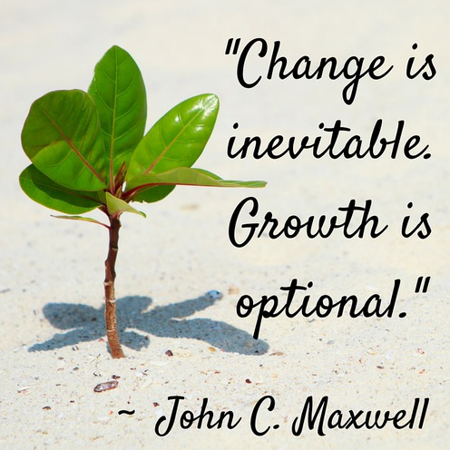

Slide 3
Workshop Goals
Recognize your approach to change
Understand sources of resistance to change
Practice strategies for framing changes to stakeholders: managers, peers, subordinates
Learn strategies for managing change over time
Notes:
Davida

Slide 4
Workshop Overview
Introductions
Awareness of Your Approach to Change
Change Profile
Peek at Bridges Change Model
Types of Cultures
Persuasive Framing
Role-play Planning (2 worksheets)
Lunch
Notes:
Davida-

Slide 5
Workshop Overview
Bridges Model: Deep-dive
Practice: Role Play #1
Case Study
Practice: Role Play #2
Managing Change over Time
Kotter Change Process Efforts and Sources of Failure
Practice: Role Play #3
Take aways
Evaluation
Notes:
Davida

Slide 6
Introductions
Name
Organization
A change you plan to examine more closely and use during role plays
Notes:
Davida lead; Marcia flip-chart responses

Slide 7
Change Profile Questionnaire
Complete the Change Profile Questionnaire
On paper
On-line with this link (emailed) https://utexas.qualtrics.com/jfe/form/SV_3aTH2g4OCOLJ6fP
Score the Change Profile Questionnaire
Automatically scored on-line
Result is for your information only
Notes:
Marcia lead--Bring on paper but also give link to on-line; let them start on on the Role play prep form

Slide 8
Change Types: Responses to Change
Resigning: Against a change but feel powerless to do anything but accept it
Resisting: Against change & actively oppose it
Adapting: Pleased with change but not interested in initiating it
Leading: Proactive about making positive change happen
Notes:
Marcia

Slide 9
Stages of Grief (negative change)
Denial: “No, not me. Can’t be true”
Anger: “#%?!!**# … Why me?”
Bargaining: “If I do ____, then that won’t happen”
Depression: “Woe is me”
Acceptance: “It’s okay”
Renewal: “I’m energized again”
Notes:
Marcia

Slide 10
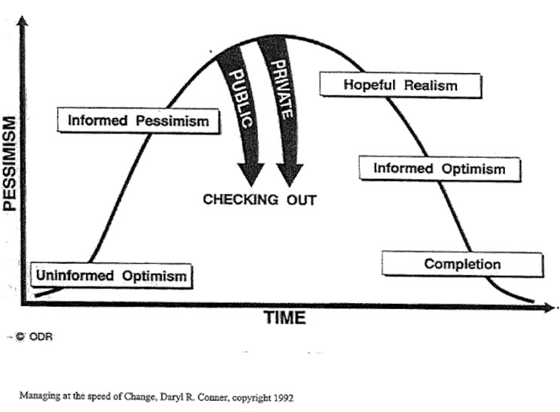
Response to Positive Change
Notes:
Marcia

Slide 11
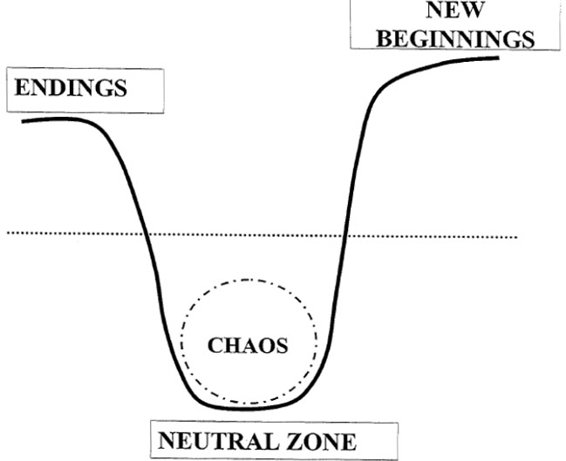
Bridges Model: Transitions
Notes:
Marcia

Slide 12
Overview of Bridges Phases
Phase | Characteristics | Reactions | Goals
Ending | Loss of: Identity, Control, Meaning, Belonging, Turf, Structure, Relationships | Denial Anger Shock | Letting go of what is being lost
Neutral Zone | Resistance to change and the unknown; Exploring new opportunities | Fear, Anger, Frustration, Stress, Confusion, Creativity, Hope | Managing fear; Beginning to explore; Testing new possibilities
New Beginning | Commitment Action | Energy, Anxiety, Enthusiasm | Achieve the new beginning
Notes:
Marcia—THEN 15 min break SHOULD BE 10:30

Slide 13
Persuasive Framing: Organizational Ecosystem
Matrix 1: Structure/Hierarchy
Matrix 2: Discourse Attitudes
Notes:
Should be 10 AM—one-half hour up to putting dots

Slide 14
Ecosystem Structure/Hierarchy: Stakeholders
Stakeholders are
knowledgeable and/or
affected by the situation under discussion and/or
responsible for final decisions/actions and/or
capable of fostering/blocking a solution
Different strategies are needed for different ecosystems
Notes:
Davida

Slide 15
Ecosystem Structure/Hierarchy
Formality of Org Chart
Continuum from Standing Committees to Ad hoc Committees
Greater formality means greater investment in the hierarchy
Participant Relations
Continuum from all Insiders to mixed to all Outsiders
Greater diversity means fewer shared assumptions and loyalties
Notes:
Davida— Here's where you should be thinking about your organization, one/more situations

Slide 16
Formality of Organizational Chart
Ad hoc Groups
Standing Committees
Legislature
Board Meeting
Cabinet Meeting
Team Meeting
Book Club
Volunteer Day
Notes:
Davida
The more formal the organization, the more familiar people will be with the groundrules

Slide 17
Participants' Relations to You
OUTSIDERS
INSIDERS
Notes:
DC The more mixed the room, the more that needs to be explained

Slide 18
Organizational Matrix
OUTSIDER
STANDING
INSIDER
AD HOC
Legislative Debate
Public Hearings
Volunteer Day
Kitchen Table
Notes:
Think about where your organization would go—or even the group within your org that you work with most. You'll get a chance to place your dotsin a moment

Slide 19
Discourse Culture
Tolerance for dissent
Continuum: communities where everyone loves to hash it out to those that loathe discord
Greater tolerance for dissent means greater openness to change
Action orientation
Continuum: communities that value airing all views to those geared toward making decisions
Greater need for action means more need for persuasion and compromise
Notes:
9:40 AM. Davida. This aspect of culture is less obvious than organizational chart but has just as much impact on how meetings work.

Slide 20
Tolerance for Dissent
HASHING
HARMONIZING
Juries
Legislature
TV News Panels
Chat Rooms
Board Meetings
Mediation
AA Meeting
Dinner Table
Notes:
Davida

Slide 21
Action Orientation
EXPRESSING
DECIDING
KITCHEN TABLE
JURY
BOOK CLUB
BULL SESSION
Notes:
Davida

Slide 22
Discourse Culture Matrix
EXPRESS
HASH
DECIDE
HARMONY
Jury
Book Club
Kitchen Table
Dinner Table
Notes:
Davida

Slide 23
Where are you?
Place dots for YOUR organization's culture on the
Organizational Structure matrix
Discourse Culture matrix
Notes:
Should be 10:30 AM time for a break

Slide 24
Communication is Key!
Why is this change necessary?
What are the benefits of the change?
What are we letting go of?
What question and concerns can we expect along the way?
What should we not expect?
Special challenges for leaders:
Balance of empathy and sense of urgency
Supporting others through the change
Notes:
Marcia should be 10:45

Slide 25
Communication Plan
Message Components | Stakeholder: | Stakeholder: | Stakeholder:
Primary Concern
Other Concern(s)
Message
Messenger(s)
When Message Will Be Delivered
How and Where (media)
Supporting or Collateral Materials
Person Primarily Responsible
Other Persons Responsible
Other Considerations
Notes:
Marcia

Slide 26
Phraseology Frames
Soliciting views, respecting positions, acknowledging difference, moving closer
Notes:
Davida; all this up to 11:30 AM

Slide 27
Phraseology Frames
Topics
Promoting discussion
Checking agreement/comprehension
Acknowledging other views
Making concessions
Stating disagreement
Defusing tension
Dealing with the unexpected
Moving in a productive direction
Promoting good will
Style adjustments
Up and down the chart
One-on-one vs. one-to-group
Formal vs. loose cultures

Slide 28
Promoting Discussion
From the top:
"I want to hear from everyone on this"
"I don't know the ins and outs, so I really need your input"
Peer to Peer:
"Remember everyone deserves respect and attention"
"Not everyone has weighed in yet"
"What do other people think?"
Looking Up:
I may be the only one, but…
From where I'm sitting, ….
Formal:
We're going to take everyone's input very seriously
Loose:
Don't be shy here…
Let's hear some reactions

Slide 29
Checking Comprehension/Agreement
"So are we agreed that we're going to give it two weeks?"
"Who still has some concerns about saying two weeks?"
"So do most people think two weeks is realistic?"
"So is two weeks a problem for anyone?"
"Am I the only one who thinks two weeks isn't enough time?"
"What if two weeks isn't enough?"

Slide 30
Acknowledging Other Views
"Here's what I hear you saying… is that right?"
"Correct me if I'm wrong"
"I understand that you prefer …."
"I know you see it a different way"
"You've helped me get a different perspective on this"
"Thanks for explaining that so clearly"

Slide 31
Making Concessions
"That option does have some things going for it"
"You're right that…"
"I agree with you that…"
"I hadn't realized that…"

Slide 32
Stating Disagreement
Peer to Peer
"Here's where we differ…"
"I'd like to see more evidence on that point"
"I also see some disadvantages"
"Let me play devil's advocate here"
"I'm still uncomfortable with this"
Looking Up
"I don't want to tell you how to do your job but I do want to share some information"
"I know you had no control over this"
"This might seem kind of touchy-feely"
"Could you clarify your goals"

Slide 33
Moving in a Productive Direction
"There are other options here that we haven't considered"
"Can we put that aside for the moment?"
"We're not really that far apart"
"Let's not make the perfect the enemy of the good"
"Is there a way to do a "both-and" instead of an "either-or"
"Could you live with…"

Slide 34
Defusing Tension
"Hang on, let's make sure we understand here"
"Let's not shut down that viewpoint too quickly"
"Remember the main goal here"
"I think we understand that viewpoint. Does anyone have a different view?"
"Let's remember the main goal here"
"Now THIS is what I call dialogue!"

Slide 35
Dealing with the Unexpected
"I don't have a solution all ready to go. We need to figure this out together"
"Let me get back to you on that"
"That's a big new idea that we'll need time to think about"
"Let's note that down and take it up at a later meeting"
"Remember this is hard"
"We don't know yet exactly what it's going to look like"
"We're on the same team here"
"It's not going to be smooth sailing"

Slide 36
Promoting Good Will
"This has been a really good discussion"
"Thanks for staying so engaged"
"That's very helpful"
"That's given us some important things to think about"
"If you think of anything else or didn't want to speak up now, please get in touch"
Notes:
DC

Slide 37
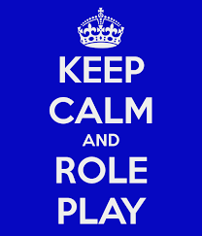
Communication is Key!
Complete the Change Role Play Preparation Worksheet
Review the Observer’s Role Play Worksheet
Notes:
Marcia

Slide 38
Role Play Preparation
Scenario Description: What is my role and who am I speaking to? What do I need to communicate? Summarize in 2-3 sentences what you need to communicate. What reaction(s) do I anticipate?
My Readiness: How am I feeling now? What stage of the Bridges change model am I in? What stage do I think my team members/stakeholders are in? What is my desired outcome from the conversation?
Communication Plan: What is my opening sentence? What are my key points? How will I invite discussion? What is my closing sentence?
Future Orientation: What are my next steps following the team member/stakeholder meeting?
Notes:
marcia

Slide 39
Lunch!

Slide 40
Overview of Bridges Phases
Phase | Characteristics | Reactions | Goals
Ending | Loss of Identity, Control, Meaning, Belonging, Turf, Structure, Relationships | Denial Anger Shock | Letting go of what is being lost
Neutral Zone | Resistance to change and the unknown Exploring new opportunities | Fear, Anger, Frustration, Stress Confusion Creativity, Hope | Managing fear Beginning to explore Testing new possibilities
New Beginning | Commitment Action | Energy, Anxiety, Enthusiasm | Achieve the new beginning
Notes:
Marcia

Slide 41
Deeper Dive: Endings
Transition Phase | Reactions | What you will HEAR | What you will SEE
Endings | Denial Anger Shock | “Just sit tight. This won’t last long” “People aren’t serious about this” "This won’t work here” | They keep working the way they’ve always worked Quality & quantity of work decreases Rumors & gossip increase
Notes:
Marcia

Slide 42
Deeper Dive: Neutral Zone
Transition Phase | Reactions | What you will HEAR | What you will SEE
Neutral Zone (Chaos) | Fear Anger Frustration Confusion Stress Skepticism Impatience Hope Acceptance Creativity | “I don’t know what I am doing” “What does this mean to ME?” Who’s in charge, & do they know what they are doing? “If you don’t know what we are supposed to do, how about we do it this way?? | Informal hallway meetings Rumor mill run rampant Procrastination Tardiness Increased absenteeism
Notes:
Marcia

Slide 43
Deeper Dive: New Beginnings
Transition Phase | Reactions | What you will HEAR | What you will SEE
New Beginnings | Energy Anxiety Frustration Enthusiasm | “Let’s get going on this” “I see ways we can make this better” “This will be exciting to try” | Willingness to try new things Forming of new relationships & partnerships Impatience with those who have not reached New Beginnings
Notes:
Marcia

Slide 44
Leadership Strategies
Transition Stage | Leadership Strategies
Endings | Reinforce the change. Check for understanding. Allow voicing of anger, frustration, concerns. Communicate, communicate, communicate Set clear expectations about performance standards
Neutral Zone (Chaos) | Meet frequently Explain the potential impact on people Communicate, communicate, communicate Provide structure Focus on short term goals Recruit high performers Be patient
Notes:
Marcia

Slide 45
Leadership Strategies (continued)
Transition Stage | Leadership Strategies
New Beginnings | Delegate work appropriately Develop new job accountabilities Emphasize the need to make it better Communicate, communicate, communicate Create an empowering environment Involve individuals as agents of change
Notes:
Marcia

Slide 46
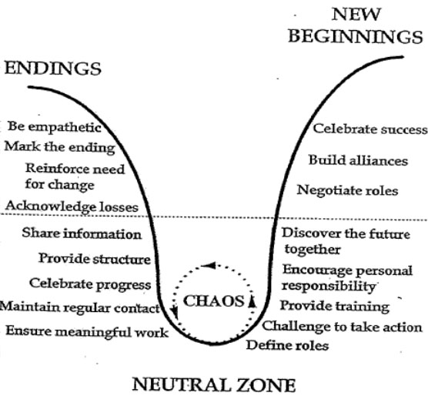
Leadership Behaviors by Bridges Model Phase
Notes:
Marcia

Slide 48
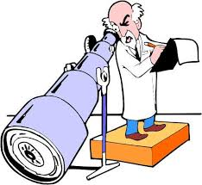


Role Play #1
Observer
Stakeholders/
Employees/
Team
Observer
Manager
Leader
Notes:
Marcia

Slide 49

Role Play Debrief
What worked well?
What was most challenging?
Aha’s?
Take-aways?
Notes:
Marcia

Slide 50
Case Study #1
Seton Healthcare Family Reduction in Force (RIF)
Need to reduce costs resulting in multiple cost-cutting measures, including eliminating 110 positions (out of approx. 9,000 employees)
Notes:
marcia

Slide 51
Seton Reduction in Force (RIF)
Strategies for Endings:
Reinforce the change
Allow voice of anger, frustration, concerns.
Communicate, communicate,…
Set clear expectations about performance standards
Leadership Actions Taken:
Share financials--transparency
Share other cost-cutting steps being taken
Share process & timing for determining positions to be eliminated; invite volunteers
Share supports for those laid off
Solicit questions, concerns
Share FAQs; address rumors
Reinforce daily standards not changing

Slide 52
Seton Reduction in Force (RIF)
Strategies for Neutral Zone:
Meet frequently
Explain potential impact on people.
Communicate, communicate,…
Provide structure
Focus on short-term goals
Recruit high performers
Be patient
Leadership Actions Taken:
Frequent communications, FAQs
Train managers to be empathetic, encourage 1:1 dialogue, express appreciation
Make EAP available
Highlight what hasn’t changed
Solicit ideas for improved procedures
Eliminate some task(s)!
Highlight # of employees placed
Recognize staff efforts to focus on short-term goals

Slide 53
Seton Reduction in Force (RIF)
Strategies for New Beginnings:
Delegate work appropriately
Develop new job accountabilities
Emphasize the need to make it better
Communicate, communicate
Create an empowering environment
Involve individuals as agents of change
Leadership Actions Taken;
Share progress -- +/-
Recognize victories, especially new procedures, eliminated work
Emphasize development opportunities, especially cross-training
Continue to solicit ideas for streamlining work
Update job descriptions; consider pay adjustments

Slide 54
Role Play #2 (adjust as needed)
Observer
Stakeholders/
Employees/
Team
Observer
Manager
Leader
Notes:
Marcia

Slide 55
Role Play Debrief
What worked well?
What was most challenging?
Aha’s?
Take-aways?

Slide 56
Kotter’s 8-Step Change Process
Establish a sense of urgency
Form a powerful guiding coalition
Create a vision
Communicate the vision
Empower others to act on the vision
Plan for and create short-term wins
Consolidate improvements and produce more change
Institutionalize new approaches

Slide 57
Kotter’s Change Process
1. Establish urgency
Describe potential crises and untapped opportunities based on market and competitive realities
Convince stakeholders (75% or more) that status quo is riskier than the unknown
2. Form a powerful guiding coalition
Assemble a group with shared commitment and enough power to lead the change effort
Instill team outlook and practices

Slide 58
Kotter’s Change Process
3. Create a vision
Create a vision to direct the change effort
Develop strategies for realizing that vision
4. Communicate the vision
Use every vehicle possible to communicate the new vision and strategies
Teach new behaviors, modelled by the guiding coalition

Slide 59
Kotter’s Change Process
Empower others to act on the vision
Remove obstacles and/or alter systems or structures undermining the vision
Encourage risk taking and nontraditional ideas and activities
Plan for and create short-term wins
Define and engineer visible performance improvements
Recognize and reward those contributing to those improvements

Slide 60
Kotter’s Change Process
Consolidate improvements and produce more change
Use increased credibility from early wins to change systems, structures, and policies that undermine the vision
Hire, promote and develop those who can implement the vison
Reinvigorate the change process with new projects and change agents
Institutionalize new approaches
Articulate connections between new behaviors and organizational success
Create leadership development and succession plans consistent with the new approach

Slide 61
Make It Stick
8. Create a New Culture
8 Step Change Process
7. Don’t Let Up
Make It Happen
6. Produce Short-Term Wins
5. Empower Others to Act
4. Communicate for Understanding and Buy-In
Decide What to Do
3. Develop the Change Vision and Strategy
2. Pull Together the Guiding Team
Set the Stage
1. Create a Sense of Urgency
Kotter, John P. and Rathgeber, Holger, Our Iceberg is Melting. New York: St. Martin’s Press

Slide 62
Why Transformation Efforts Fail
Not enough urgency
Weak guiding coalition
Lack of vision
Under-communicating the vision by a factor of 10
Not removing obstacles to the new vision
Not planning for and creating short-term wins
Declaring victory too soon
Not anchoring changes in the organization’s culture

Slide 63
Case Study #2
Ascension ERP: Project Symphony
Design and implement system (software and processes) to standardize Finance, HR and Supply Chain operations across 40 health systems in 22 states.
$1.5 billion initiative over ~5 years
Notes:
marcia

Slide 64
Ascension ERP: Project Symphony
Establish a sense of urgency
2. Form a powerful
guiding coalition
Leadership Actions Taken:
Benchmark current costs, industry consolidation
Highlight inefficiencies and risk of less $$ for patient care
Promote vision of system-ness
Form steering committee with powerful advocates and skeptics
Recruit project team – internal and external
Conduct team building for project team

Slide 65
Ascension ERP: Project Symphony
3. Create a vision:
4. Communicate the vision:
Leadership Actions Taken:
Do cost/benefit analysis
Form process teams (benefits, budget, etc.)
Solicit vendor proposals (chose PeopleSoft)
Create prototypes and share via video, FAQs, roadshows, website, hands-on demos, etc.
Address skeptics; connect with our values
Create rollout scenarios
Conceptualize new jobs, org.

Slide 66
Ascension ERP: Project Symphony
5. Empower others to act on the vision
6. Plan for and create
short-term wins
Leadership Actions Taken;
Assess local change readiness
Share progress reports
Prepare local systems for the changes ahead—expect bumps, resistance, excitement
Recruit/tout Alpha and Beta sites
Recruit opinion leaders, advocates
Tensions: Separate Symphony organization with different “rules”

Slide 67
Ascension ERP: Project Symphony
7. Consolidate improvements to produce more change
8. Institutionalize new approaches
Leadership Actions Taken;
Standup Shared Services Center
Recruit and train change champions
Redesign jobs at local systems; people apply for new jobs
Some promotions, some layoffs
Make midcourse corrections
Replace/reinvigorate the original Symphony project team
Celebrate progress; the way we now work!

Slide 68
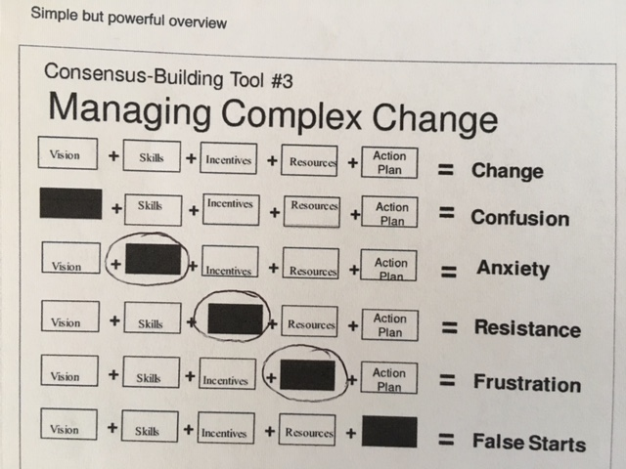
Managing Complex Change

Slide 69
Role Play #3 (adjust as needed)
Observer
Stakeholders/
Employees/
Team
Observer
Manager
Leader
Notes:
Marcia

Slide 70
Role Play Debrief
What worked well?
What was most challenging?
Aha’s?
Take-aways?

Slide 71
Recap
Change profile
Types of cultures
Persuasive framing
Bridges change model
Kotter 8-step change process
Practice, practice, practice!

Slide 72
Take aways
What did you learn?
What questions do you have?
Note: List of Selected Resources provided.

Slide 73

Lessons from the Geese

Slide 74
Thank you! Feel free to get in touch any time!
Davida Charney, Ph.D. Marcia Silverberg, MSW
Professor of Rhetoric and Writing Principal, HR Directions
dcharney@austin.utexas.edu Marcia@hr-directions.com
https ://sites.dwrl.utexas.edu/charney/ http://www.hr-directions.com

