Slide 1
Flourishing in the Workplace
Human Dimensions of Organizations
Caryn L. Carlson, Ph.D. Michael Starbird, Ph.D.
Department of Psychology Department of Mathematics
October 22, 2021

Slide 3
Your challenges
This seminar aims to help you meet challenges in your work life. To help make the material more relevant to you, think of one or two problems or challenges you are facing. You will hear about strategies that may help you to address them effectively.

Slide 4
“What makes you so special?”

Slide 5
Outline
A Positive Psychology perspective
Happiness is Good
Happiness at Work
Happiness at Work can be increased: Work as a Calling
  Identifying and using character strengths
  Increasing positive emotion
  Cultivating relationships
  Encouraging flow
  Developing strengths of effective thinking

Slide 6
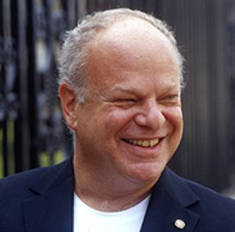
Positive Psychology
1998 President’s Address to APA
Martin Seligman
  “At this juncture, psychology can play an enormously important role. We can articulate a vision of the good life that is empirically sound and, at the same time, understandable and attractive. We can show the world what actions lead to well-being, to positive individuals, to flourishing communities, and to a just society.”

Slide 7

Positive Psychology
“Positive psychology is the scientific study of what makes life worth living.”
        Christopher Peterson

Slide 8

What is Positive Psychology (not)?

Slide 9
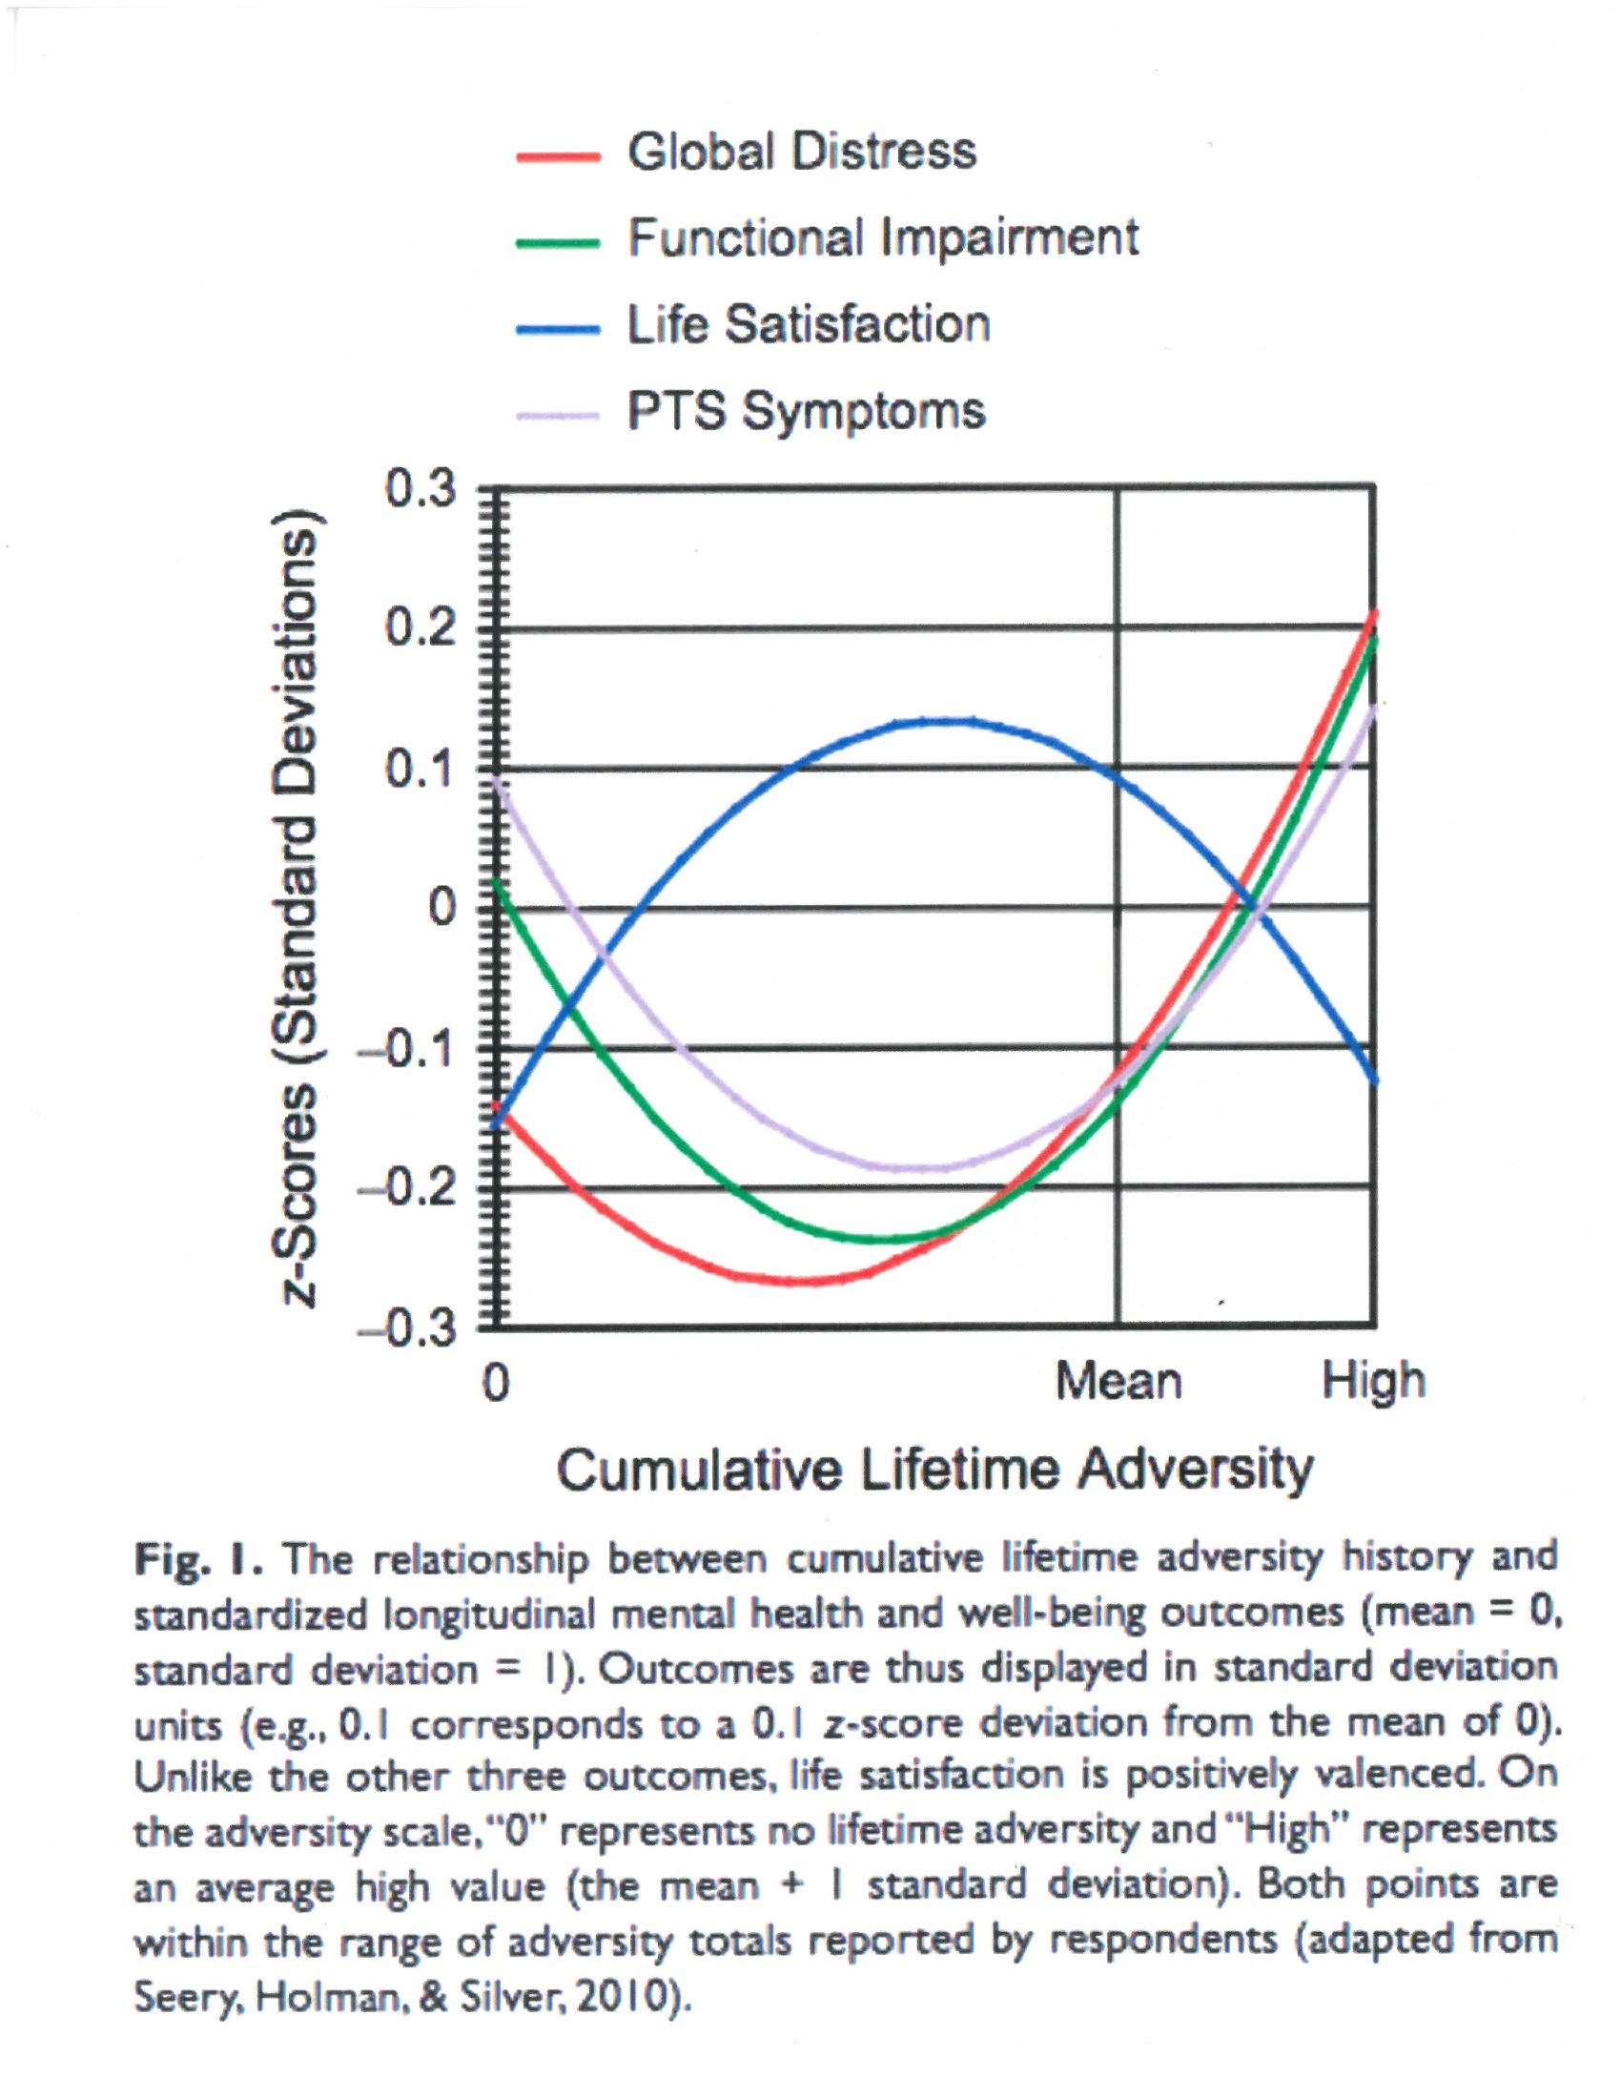

Slide 10
What is happiness?

Slide 11

Subjective well-being
  Moment-to-moment emotions
    The quality of
    one’s affective life; experiencing high levels of positive emotion and low levels of negative emotion

Slide 12
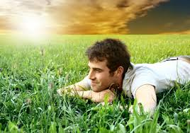
Subjective well-being
  Life satisfaction
    Being generally satisfied with one’s life; having a sense of worth, achievement, and fulfillment

Slide 13


How is Subjective Well-being measured?
SELF REPORT EXPERIENCE SAMPLING

Slide 16
Moment-to-moment happiness:
Experience Sampling (ESM) Survey
What are you doing?
  Shopping, eating, housework, working
With whom are you interacting?
How are you feeling
  0 (not at all) to
  6 (very much)
Positive
  Happy
  Warm/friendly
  Enjoying myself
Negative
  Frustrated
  Sad
  Angry
  Worried/anxious

Slide 17
Is Happiness Good?

Slide 18

Is Happiness Good?
Relationships
  More friends & social support
  More satisfied
  with friendships
  Happier and
  more fulfilling marriages

Slide 19
Is Happiness Good?
Health
  Fewer self- reported
  physical & mental
  health symptoms
  More active and energetic
  Enhanced immune function
  Older adults who are happier show slower decline in physical function and fewer impairments in daily activities (Steptoe et al,2014)
  Live longer!

Slide 20
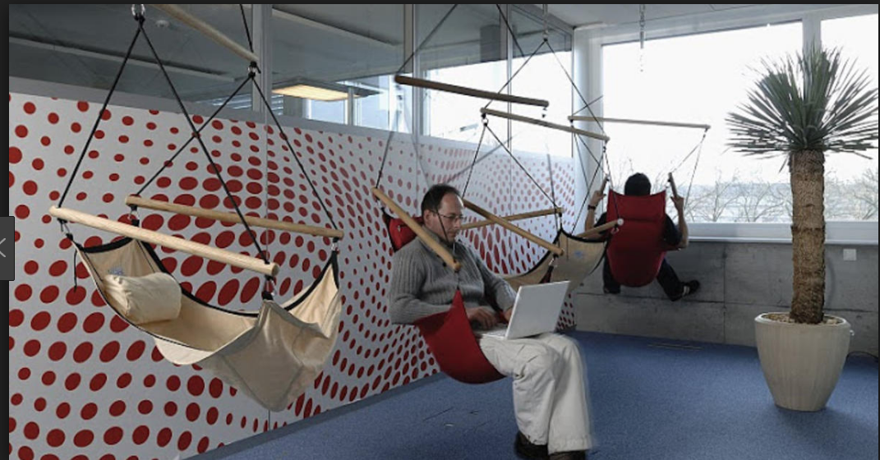
Is Happiness Good?
Work
  More likely to get
  job interviews
  Superior performance
  & productivity
  Higher supervisor ratings
  More organizational
  citizenship
  Higher incomes
    Positive affect in adolescence/early adulthood associated with higher income at age 29

Slide 21
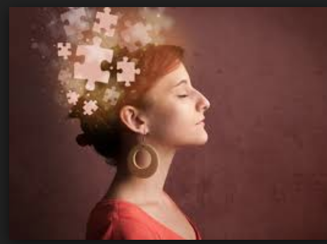
Is Happiness Good?
Creativity and Problem-solving
  Induced positive moods suggest pleasant emotions lead to more flexible thinking and originality

Slide 22
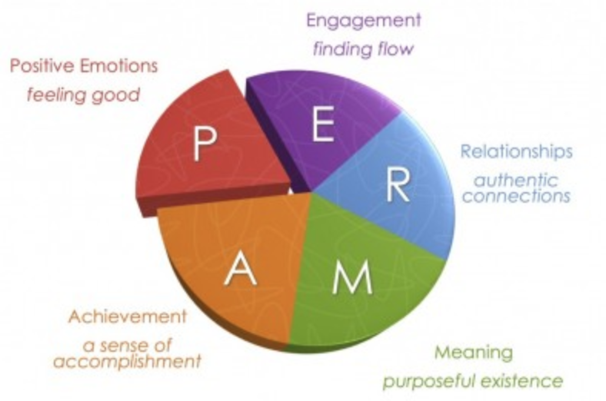
Seligman’s PERMA Model of Subjective Well-Being

Slide 23
A WEIRD caveat….

Slide 24
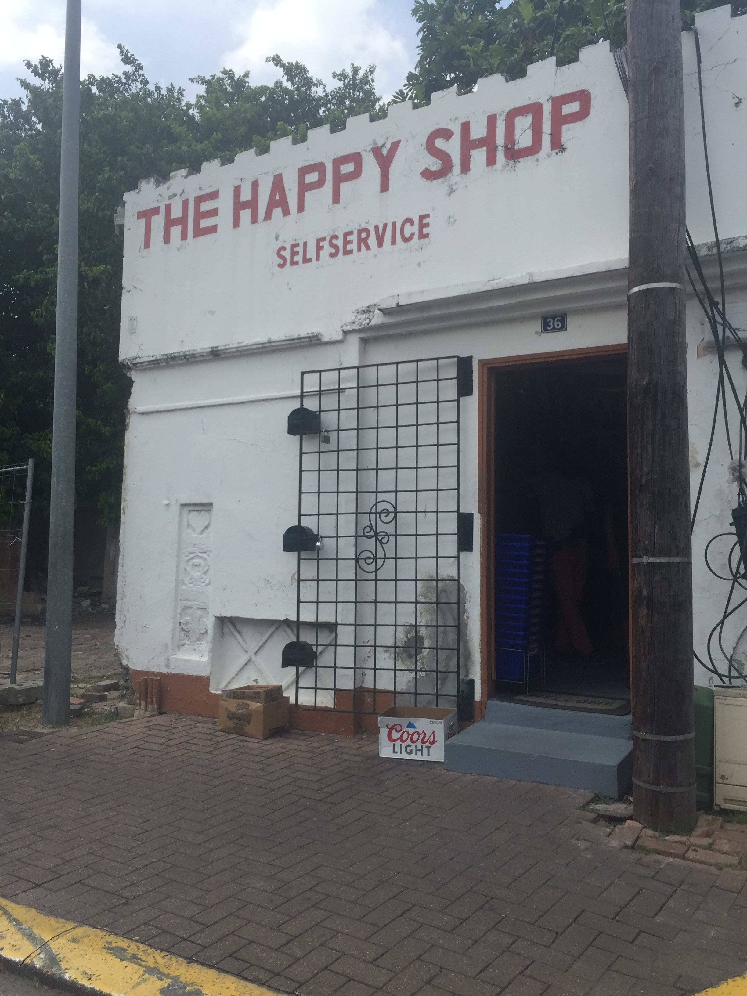
The Secret to Happiness…

Slide 25


How happy are Americans at work?

Slide 26
General Social Survey (2018)
48% “Very satisfied”
41% “Somewhat satisfied”

Slide 27
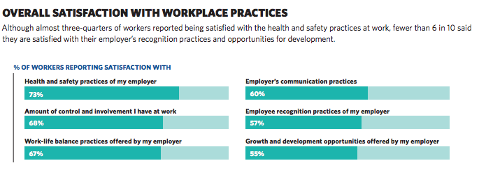
2018 Work and Well-Being Report www.infocoponline.es/pdf/work-and-wellbeing-survey-results.pdf

Slide 28
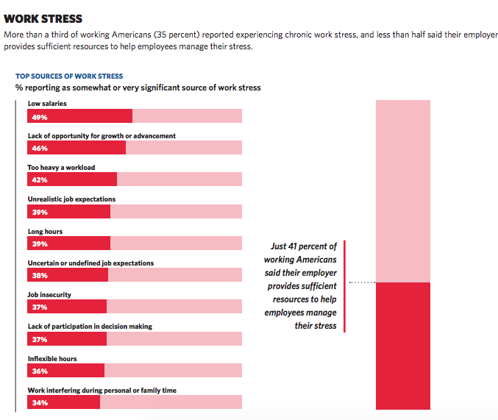
2018 Work and Well-Being Report

Slide 29
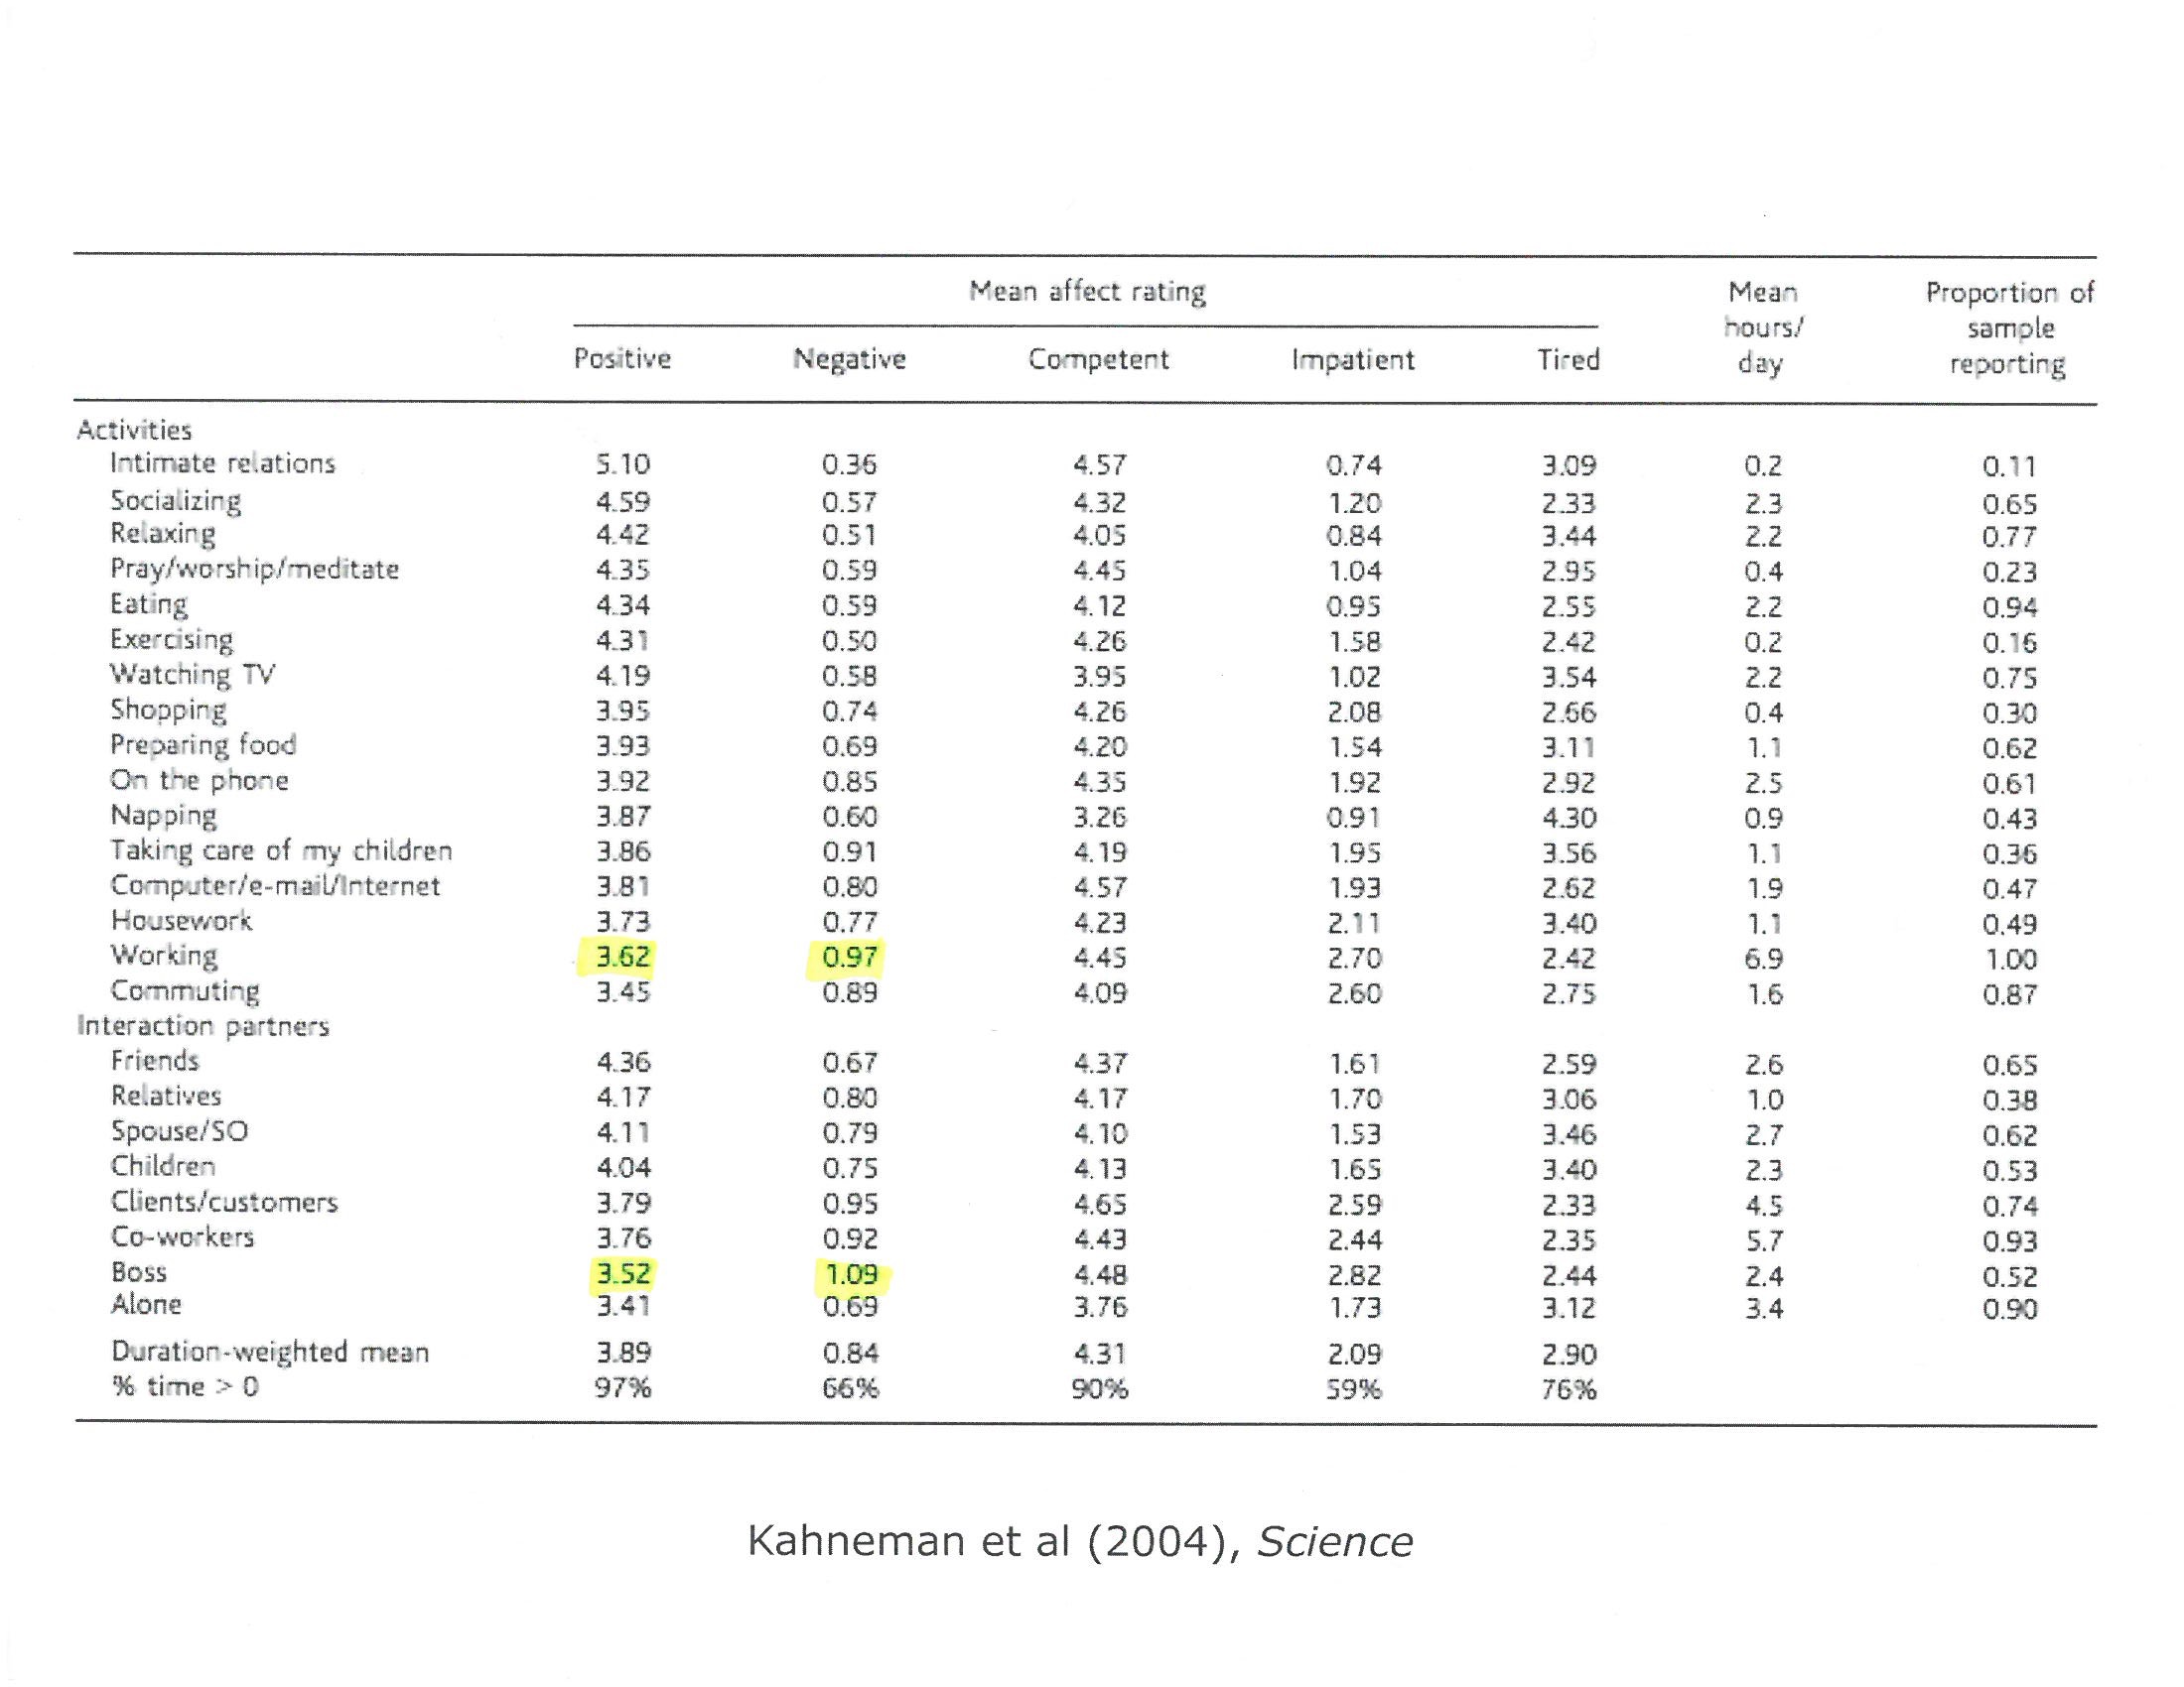

Slide 30
Americans at Work
Happy?
Unhappy?

Slide 31
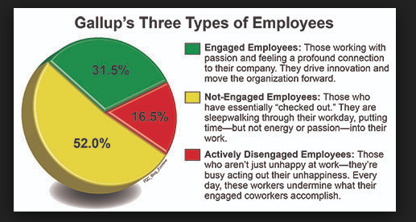
Employee Engagement
Work as a Calling

Slide 32

Promoting Engagement/Calling:
Effects on Employee
“An ability to fulfill one’s core values at work”
Work hard because job is rewarding
“Calling” associated with higher life and work satisfaction, greater passion about and identification with work, frequent experiences of flow during the work day, lower depression and stress

Slide 33
Promoting Engagement/Calling:
Effects on Organization
Best way to gain competitive advantage is to recruit and retain capable, dedicated, and engaged employees
  Proactive behaviors (productivity, customer service, work quality)
  Withdrawal behaviors (turnover, absenteeism, accidents)
  “Bottom line” measures (customer loyalty, financial performance)

Slide 34

Conditions for Engagement
Work as a Calling
You enjoy the work
You’re good at the work
You believe the work stands for something and makes a difference

Slide 35
Working
Studs Terkel (1974)
“Masonry is older than carpentry, which goes clear back to Bible times,” a stonemason told him. “Stone is the oldest and best building material that ever was.”
A hotel switchboard operator said, “You cannot have a business and have a bad switchboard operator. We are the hub of that hotel.”
A twenty-six-year-old stewardess told Terkel, “The first two months I started flying I had already been to London, Paris, and Rome. And me from Broken Bow, Nebraska.”

Slide 36
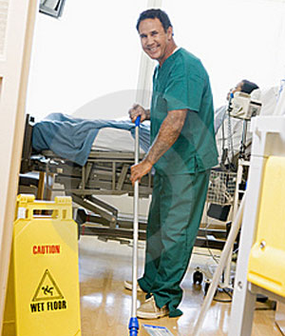
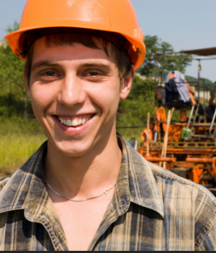
Work as a Calling

Slide 37

Invoking Mission by Connecting to Outcomes
Testimonials to connect to mission
  When callers for university fundraising the night before calling read stories about students who had received scholarships, they raised twice as much as those reading stories about personal job benefits or no stories

Slide 38
Invoking Calling/Mission through Job Description
Consider your job (or another job in your company) and write an advertisement with a “calling description” that would entice others to apply for the job.

Slide 39
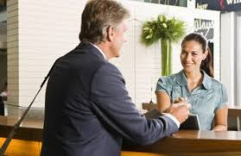
Administrative Assistant/Receptionist
“First impression administrator”
  You are the first point of contact in…providing exceptional customer service with a smile and a sense of humor. You greet visitors and answer multi-line telephone with a cheerful and helpful tone. You take pride in maintaining a reception area that is professional and welcoming. You serve the educational mission by documenting…, thereby insuring that students are able to attend classes.
  Required qualifications: A strong desire to serve and to communicate with the public. The ideal candidate has innate interpersonal skills…., dedication to a high level of accuracy…person called to this position will have well-honed technical skills…The love for helping people will drive this person to be punctual and dependable.
                Del Watson

Slide 40
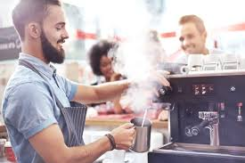
Starbucks Barista
“My job is all about the human connection. I just happen to serve really good coffee and tea. People are hard-wired for connection; it’s why we’re here. I’m lucky, at my job I make connections every minute with all types of people. I have the privilege of starting hundreds of people’s days simply with a recipe for their favorite cup of coffee. I have the honor of seeing families journey through different stages of their lives. Whether graduation, birthdays, weddings, funerals, holidays…I get to share a tiny glimpse…Sometimes I have the delicate responsibility of listening as they tell me their dog has passed away, other times I get to join in the excitement as they take their wedding party the caffeine that will take them through a night of celebration. There’s nothing like the surprise on a customer’s face when you remember their drink after not having seen them for eight years. Because it’s not just about the drink, it’s about the relationship.” - Ximena Lucia Baez

Slide 41
Positive Psychology Practices for the workplace
  Identifying and using character strengths
  Increasing positive emotion
  Cultivating relationships
  Encouraging flow
  Developing strengths of effective thinking

Slide 42
Character Strengths and Virtues

Slide 43
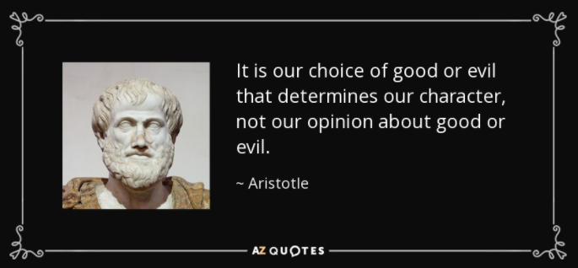
Character Strengths and Virtues

Slide 44
Deficit vs. strength-focused approaches
Deficit-focused
Strength-focused
Building capacity
Enhancing competencies
Studying what’s right with people
Fixing problems
Identifying deficits
Studying what’s wrong with people

Slide 45
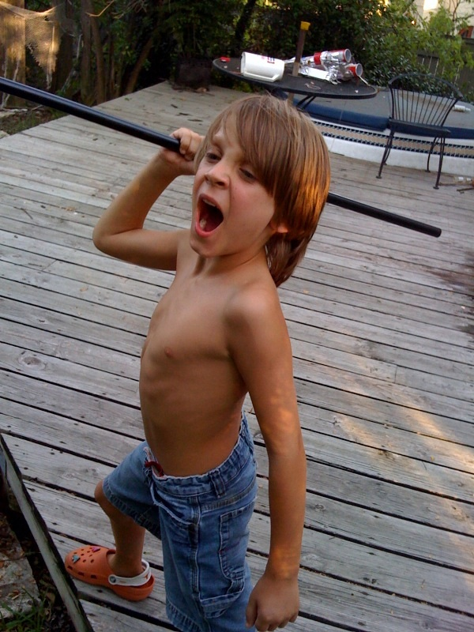
My Son and the lessons of t-ball….

Slide 46

VIA Survey of Character Strengths
An analysis and compilation of core human excellences found from history’s great philosophers, religions, and traditions
Looking for strengths that emerged consensually across cultures and throughout time
240 questions measure 24 strengths within 6 virtue categories

Slide 47
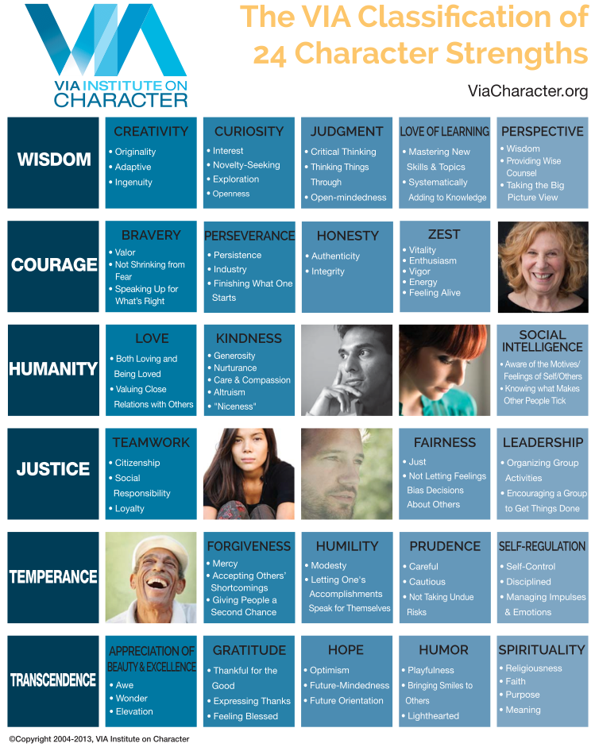

Slide 48
Workplace Strengths Intervention
78 physical rehabilitation workers completed self-report measures before and after a strength development intervention
The intervention increased participants’ strengths use and well-being
Those reporting highest post-intervention strengths use also had significant increases in work performance and harmonious passion

Slide 49
Additional Research
Website for comprehensive list of recent studies addressing character strengths in the workplace to improve the skills of leaders teams, and organizations.
https://www.viacharacter.org/research/findings/character-strengths-in-the-workplace-and-organizations

Slide 50
Knowing, developing, and using strengths
“Introduce yourself by telling a story about a time you used a character strength”
A strength-based approach for connecting to oneself and to others

Slide 51
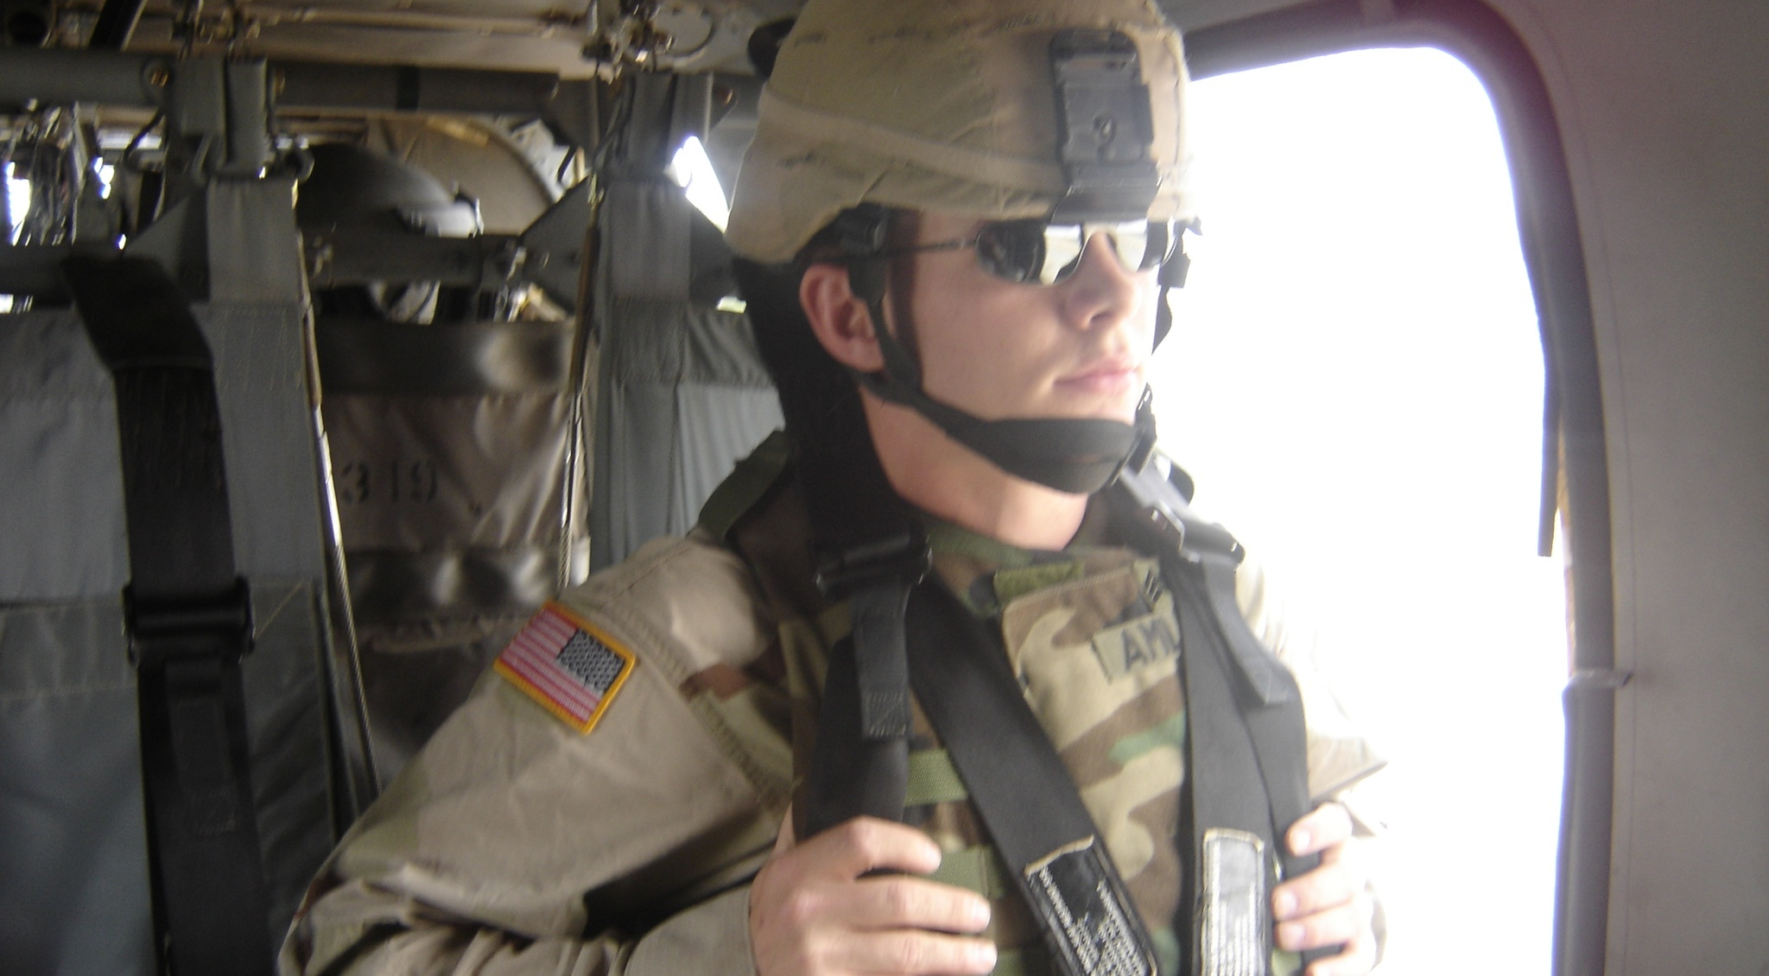
Jonathan’s Story
Using character strengths in Iraq

Slide 52
Group Exercise: Using Strengths
Identify a problem/challenge you are facing at work. Review the list of your top character strengths. Consider ways that you might use an area of strength to address the issue. Discuss with group members.

Slide 53
Positive Emotion

Slide 54
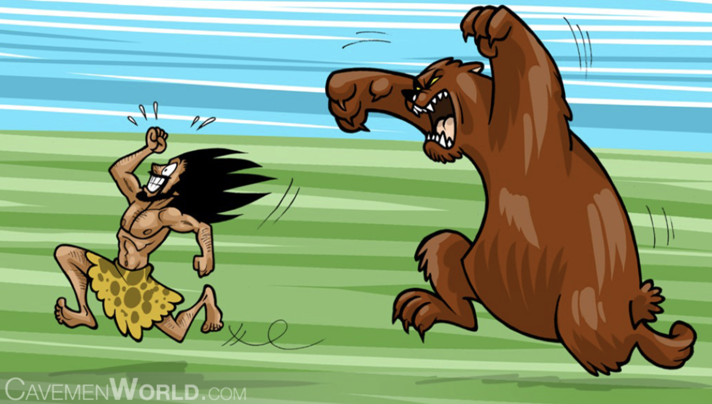
Broaden and Build Theory of Positive Emotion (Frederickson, 2005)
-Most emotion theories based on negative emotion
-Negative emotions narrow a person’s momentary thought-action repertoire
fear -> escape or attack
Adaptive in situations in which quick, decisive action is needed
-BUT- long term survival isn’t only dependent on surviving the wolf attack
-acquiring resources, building skills, forming relationships

Slide 55

Role of Positive Emotion
-Imagine feeling joy….
-Expansive feeling
Broadens what we consider doing and investigating, and promotes creativity, curiosity, and interest
Inspires us to tackle new experiences, become open to new ideas, push for greater achievements, seek out connections with others

Slide 56
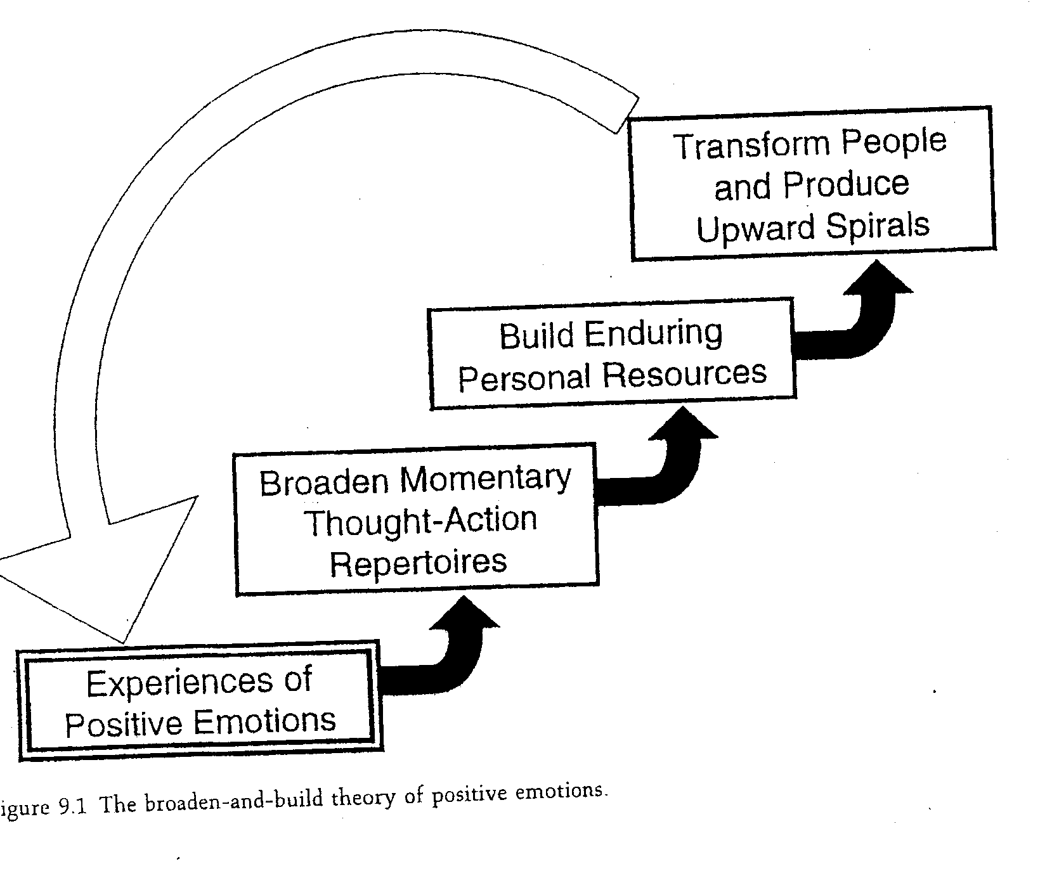

Slide 57
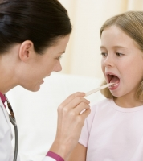
Positive Emotions and Clinical Reasoning in Physicians
Physicians “thought aloud” while they solved a case of a patient with liver disease
Physicians randomly assigned to positive affect induction condition initially considered the diagnosis earlier and demonstrated less anchoring distortion (or inflexibility in thinking)

Slide 58
Implications for the Workplace
Decrease negative emotion (e.g., stress, anxiety, fear)
  Effects of “pressure to work quickly”
Increase positive emotion via “micro-moment practices”, which can lead to consequential shifts in attention and awareness
  Can disengage from narrow focus induced by negative emotion and foster broad thinking
Especially relevant for tasks calling for non-routine, innovative, creative, conceptual skills
DISCUSSION: What specific behaviors/situations might be used to increase positive emotion in your workplace?

Slide 59
Positive Relationships: Building Connections in the Workplace

Slide 60

Relationships at Work
More socially connected workers perform better
  Recent study showed that 40% of respondents named their colleagues as the top reason they enjoy their work (Virgin)
  Single best predictor of team achievement in a financial services company was how members felt about each other

Slide 61
Positive Emotion and Connection
Love 2.0
Love is connection
  “Love blossoms anytime two or more people – even strangers- connect over a shared positive emotion, be it mild or strong.”
Positivity Resonance
  Shared positive emotions
  Biobehavioral synchrony
  Mutual care
Jeremy’s story

Slide 62
Ideas for Building Relationships at Work (even in the Days of Covid)
Check in
  Something you’re grateful for
  Something that made you smile or laugh
  Favorite- book, show, recipe, quotation
Sharing ideas
  ”Slide show”
  Lead a class
  Book Club
Strength introductions
“Factoid” exercise
  Each person submits a surprising fact about themselves and co-workers try to match the person with the fact

Slide 63
Exercise: Creating a community at work
Review your job, work routines, and work attitudes. Which parts of your job do you carry out with, or in the presence of, others? For what proportion of time, during these moments, do you make a conscious effort to connect? Do you slow down enough to really listen and make eye contact? Do you allow yourself and others to go “off topic” in ways that build relationships? How might you devote more of your energy toward cultivating positivity resonance? What new rituals or habits could you create to bring more connection into your workday? What metrics would help you and your coworkers know whether this investment pays off?

Slide 64
Finding Flow

Slide 65
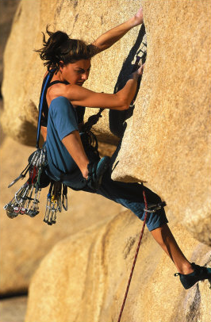
Flow
The state experienced when a person in an activity is fully immersed in a feeling of energized focus, full involvement, and success in the process of the activity.
In this state, “nothing else seems to matter; the experience is so enjoyable that people will continue to do it even at great cost, for the sheer sake of doing it”
http://www.youtube.com/watch?v=acuIYlVDUPs (to :45 and 1:45-3:40)

Slide 66
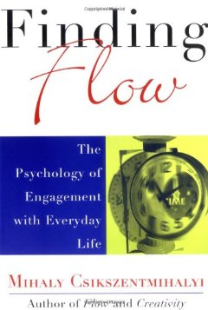
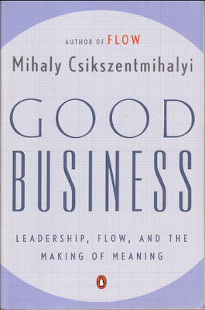
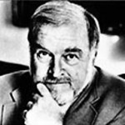
Flow
Mihalyi Csikszentmihalyi

Slide 67
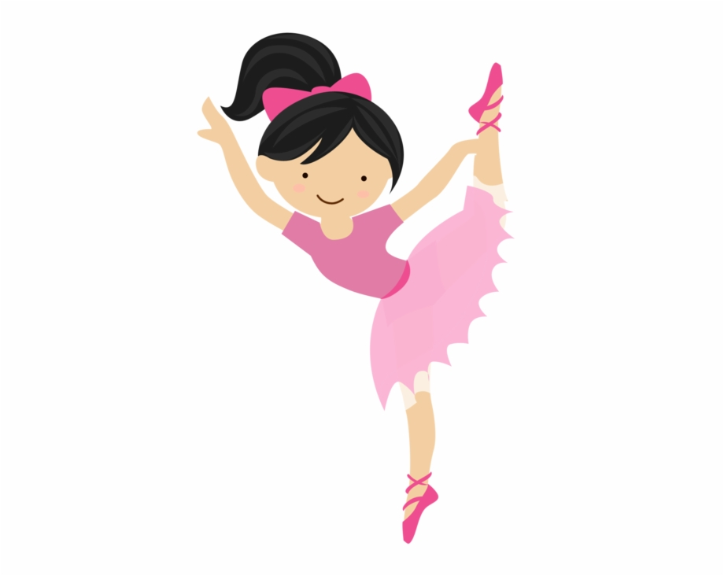

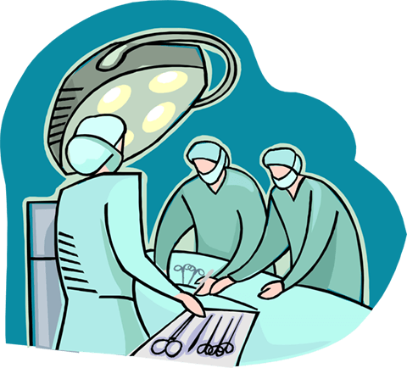
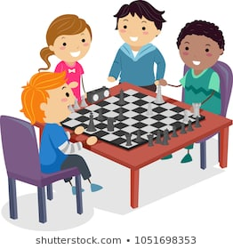
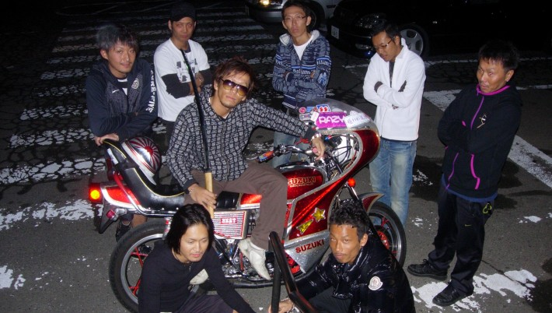
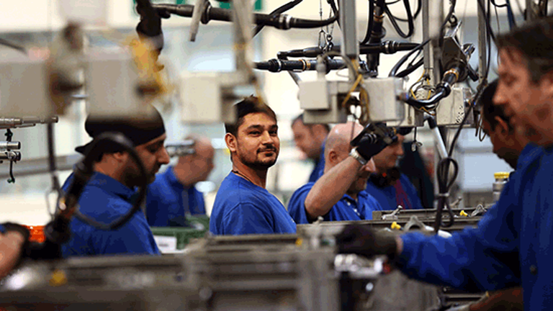
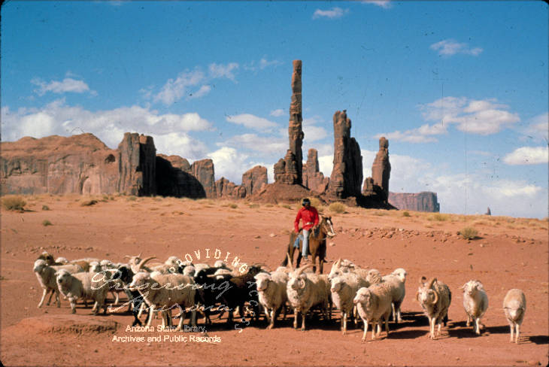
Finding Flow
Pilots
  :
Dancers
Chess players
Surgeons
Navajo Shepherds
Japanese teenage motorcycle
gang members
Assembly line workers
in Chicago

Slide 68
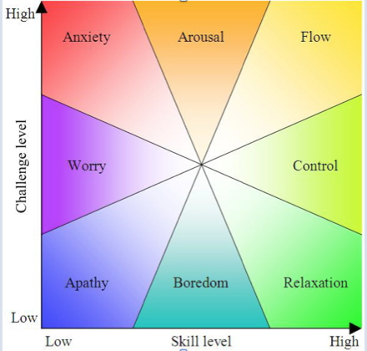
Model of Flow
Interactional Model
  Dynamic exchange between person and environment
Balance between:
  Skills and challenges
Eight experiential channels

Slide 69
Flow: Elements
Based on interviews with over 10,000 people
8 Elements of Flow:
  Goals are clear
  Feedback is immediate
  A balance between skill and challenge
  Concentration deepens
  The present is what matters
  A sense of control
  The sense of time is altered
  The loss of ego

Slide 70

The Four F’s of Flow https://www.youtube.com/watch?v=DXD8QjpQrFc (8 minutes)
Focus
Feedback
4% Challenge (to increase skills)
Freedom/Control

Slide 71
Additional Flow Enhancing Techniques
Freedom/Control
Task
  20%/day on task of own choosing (3M, Google)
Time
  Results Only Work Environment (ROWE)
    Vacation anytime if work gets done (Netflix)
Technique
  Call line explicit directive to “serve the people” (Zappo’s)
Team
  Employee chooses team (Facebook)

Slide 72
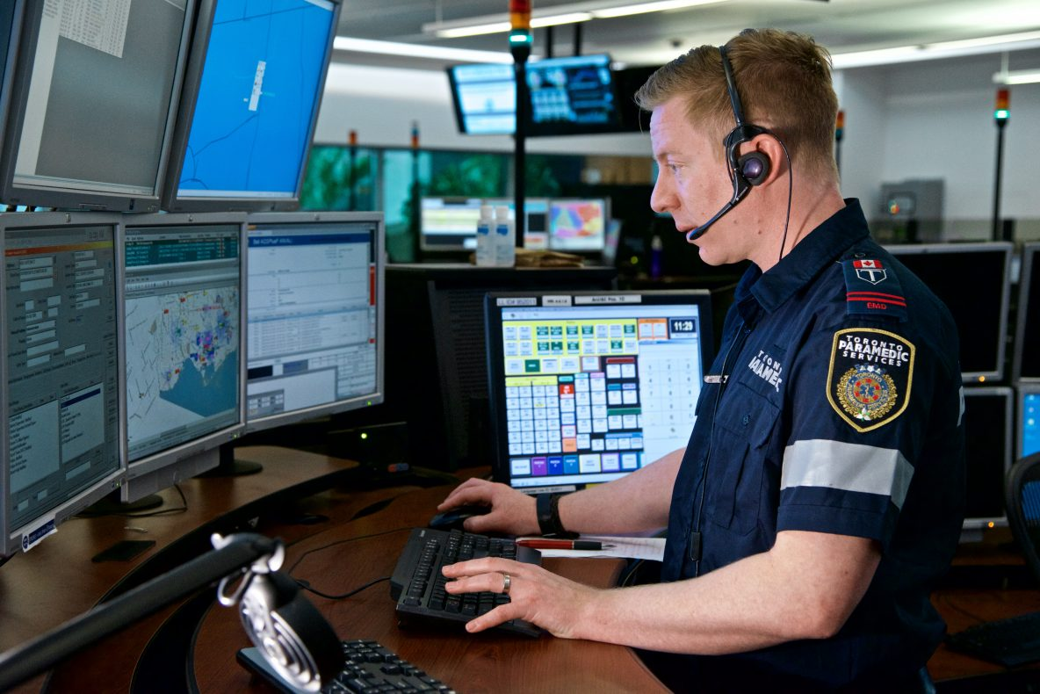
Research: 911 dispatchers and flow?

Slide 73
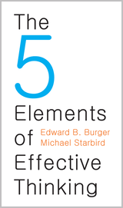

Slide 74
The 5 Elements of Effective Thinking
1. Earth: Grounding Your Thinking: Understand Deeply
2. Fire: Igniting Your Imagination: Failing to Succeed
3. Air: Creating Questions Out of Thin Air: Become Your Own Socrates
4. Water: Flow of Ideas: Look Back, Look Forward
5. The Quintessential Element: Change

Slide 75
Discussion Question
Think of an example where understanding deeply and revisiting basics could enhance your performance.

Slide 76
EARTH-Grounding Your Thinking: Understanding Deeply
1. Understand simple things deeply
2. Clear the clutter----seek the essential
3. See what’s there
4. See what’s missing
5. Final thoughts: Deeper is better

Slide 77
Discussion Question
”What were they thinking?”
  What beliefs, cultural habits, opinions, or actions that are accepted today will be viewed as ridiculous or reprehensible in 50 or 100 years?

Slide 78
FIRE-Igniting Your Imagination: Failing to Succeed
1. Welcome accidental missteps—let your errors be your guide
2. Finding the right question to the wrong answer
3. Failing by intent
4. Final thoughts: A modified mindset

Slide 79
AIR-Creating Questions Out of Thin Air: Become Your Own Socrates
1. How answers can lead to questions
2. Creating questions enlivens your curiosity
3. What’s the real question?
4. Final thoughts: The art of creating questions and active listening

Slide 80
WATER: Flow of Ideas: Look Back, Look Forward
1. Understanding current ideas through the flow of ideas
2. Creating new ideas from old ones
3. Final thoughts: “Under construction” is the norm

Slide 81
The Quintessential Element
5. Engaging Change: Transform Yourself

Slide 82
Group Exercise: Flourishing
Identify a problem/challenge you are facing at work. Apply one or more the practices from today’s seminar:
  Increasing Positive Emotion
  Using Character Strengths
  Finding Flow
  Building Relationships
  Employing Effective thinking strategies

Slide 83
Flourishing in the Workplace
Human Dimensions of Organizations
Caryn L. Carlson, Ph.D. Michael Starbird, Ph.D.
Department of Psychology Department of Mathematics
hdo.utexas.edu
October 22, 2021

Slide 84
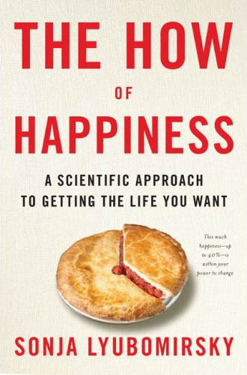
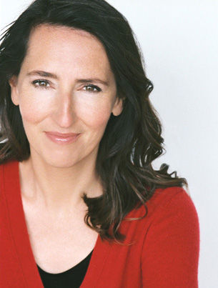
Sonja Lyubomirsky
Professor, Department of Psychology
UC-Riverside

Slide 85
Recommended readings
Daniel Pink (2009). Drive: The surprising truth about what motivates us
Shawn Achor (2010). The Happiness Advantage: The seven principles that fuel success and performance at work
Emma Seppala (2016). The Happiness Track: How to apply the science of happiness to accelerate your success

Slide 86
Outside/Follow-up Group Exercise: Finding Strengths
Prompt: “Give some thought to a time when you feel you were at your best: handling a difficult situation, helping another person, meeting a challenge, solving a problem, coming up with a good idea- something you’d be proud to have others know about you.”
Present stories to the group; discuss and identify strengths reflected in the story.

Slide 87
Outside Exercise- Connecting with others through strengths assessment
Ask a relative (or co-worker/supervisee) to take the VIA Character strengths survey. Interview them based on the results.
Stories from students

Slide 88
Outside Exercise- Using Strengths
Brainstorm ways to use one of your strengths in a new and different way at work
  Example: social intelligence and email
“Use one of your top strengths in a new and different way every day for five days.”
Multiple studies have shown this exercise results in increased happiness and decreased depression for 3 to 6 months

